Slide 1
互联网体系结构 拥塞控制

Slide 2
TCP/IP协议栈
Applications (e.g. Telnet, HTTP)
TCP
UDP
ICMP
IP
ARP
Link Layer (e.g. Ethernet, ATM)
Physical Layer (e.g. Ethernet, SONET)

Slide 3
传输层协议
实现端到端的数据传输
Protocol implemented entirely at the ends
Fate-sharing
Completeness/correctness of function implementations
Notes:
Fate sharing in unicast applications means that so long as there is a path that IP can find between two applications, then TCP can hang on to the connection as long as they like. However, if either party fails, the connection certainly fails.
Fate-sharing is an engineering design philosophy where related parts of a system are yoked together, so that they either fail together or not at all.

Slide 4
传输层协议
UDP provides just integrity and demux
TCP adds…
Connection-oriented
Reliable
Ordered
Point-to-point
Byte-stream
Full duplex
Flow and congestion controlled

Slide 5
TCP协议的变迁
1975
Three-way handshake
Raymond Tomlinson
In SIGCOMM 75
1984
Nagel’s algorithm
to reduce overhead
of small packets;
predicts congestion collapse
1987
Karn’s algorithm
to better estimate round-trip time
1990
4.3BSD Reno
fast retransmit
delayed ACK’s
1983
BSD Unix 4.2
supports TCP/IP
1986
Congestion collapse
observed
1988
Van Jacobson’s algorithms
congestion avoidance and congestion control
(most implemented in 4.3BSD Tahoe)
1974
TCP described by
Vint Cerf and Bob Kahn
In IEEE Trans Comm
1982
TCP & IP
RFC 793 & 791
1975
1980
1985
1990
Notes:
Nagel’s algorithm. RFC 896: Congestion Control in IP/TCP Internetworks
Karn’s algorithm. TCP adjusts the timeouts in agreement with the Round-Trip-Time (RTT) estimation for the current end-to-end path. RTT estimation is often called Smoothed-Round-Trip-Time (SRTT) and is obtained by averaging the measured RTT for the packets sent so far (the details will be described in the next section). Then, in the original RFC 793 TCP, the retransmit timeout (RTO) is set as twice the SRTT .
A problem arises from the way samples are taken for the calculation of the average: TCP is unable to distinguish two separate acknowledgements for the same sequence number. Therefore, we have the following problem:
A timeout occurs before an ACK is received, and PKT1 is retransmitted. The ack for the first PKT1 arrives a bit later and the source measures a wrong value for the RTT.
Phil Karn, radio-packet enthusiast, proposed the following modification to TCP:
Do not take into account the RTT sampled from packets that have been retransmitted.
On successive retransmissions, set each timeout to twice the previous one.

Slide 6
TCP协议的变迁
1994
T/TCP
(Braden)
Transaction
TCP
1996
SACK TCP
(Floyd et al)
Selective Acknowledgement
2008
CUBIC
1996
Hoe
Improving TCP startup
2004
BIC
2016
BBR
Google
1993
TCP Vegas
(Brakmo et al)
real congestion avoidance
1994
ECN
(Floyd)
Explicit
Congestion
Notification
1996
FACK TCP
(Mathis et al)
extension to SACK
1993
1994
1996
2004
2008
2016
Notes:
RFC1644: T/TCP -- TCP Extensions for Transactions Functional Specification
TCP was designed to around the virtual circuit model, to support streaming of data. Another common mode of communication is a client-server interaction, a request message followed by a response message. The request/response paradigm is used by application-layer protocols that implement transaction processing or remote procedure calls, as well as by a number of network control and management protocols (e.g., DNS and SNMP).
Currently, many Internet user programs that need request/response communication use UDP, and when they require transport protocol functions such as reliable delivery they must effectively build their own private transport protocol at the application layer. Request/response, or "transaction-oriented", communication has the following features:
The fundamental interaction is a request followed by a response.
(b) An explicit open or close phase may impose excessive overhead.
(c) At-most-once semantics is required; that is, a transaction must not be "replayed" as the result of a duplicate request packet.
(d) The minimum transaction latency for a client should be RTT + SPT, where RTT is the round-trip time and SPT is the server processing time.
(e) In favorable circumstances, a reliable request/response handshake should be achievable with exactly one packet in each direction.
Hoe. Improving the Start-up Behavior of a Congestion Control Scheme for TCP. Sigcomm 1996.

Slide 7
可靠性模型
Reliability => requires redundancy to recover from uncertain loss or other failure modes
Two types of redundancy:
Spatial redundancy independent backup copies
Forward error correction (FEC) codes
Problem: requires huge overhead, since the FEC is also part of the packet(s) it cannot recover from erasure of all packets
Temporal redundancy retransmit if packets lost/error
Lazy: trades off response time for reliability
Design of status reports and retransmission optimization important

Slide 8
前向纠错编码
add redundancy to recover from losses
original file (n blocks)
encoding
infinite number of blocks
lossy channel
receive (1+ε) blocks
decoding
recover file

Slide 9
时序冗余模型
Packets
Sequence Numbers
CRC or Checksum
Timeout
ACKs
NAKs
SACKs
Bitmaps
Status Reports
Retransmissions

Slide 10
错误的类型和效果
Forward channel bit-errors (garbled packets)
Forward channel packet-errors (lost packets)
Reverse channel bit-errors (garbled status reports)
Reverse channel packet-errors (lost status reports)
Protocol-induced effects:
Duplicate packets
Duplicate status reports
Out-of-order packets
Out-of-order status reports
Out-of-range packets/status reports (in window-based transmissions)

Slide 11
基本机制
Mechanisms:
Checksum in pkts: detects pkt corruption
ACK: “packet correctly received”
NAK: “packet incorrectly received”
Provides reliable transmission over:
A forward channel which has bit-errors; reverse: ok
Cannot handle reverse-channel bit-errors; or packet-losses in either direction

Slide 12
更多的机制
Mechanisms:
Checksum: detects corruption in pkts & acks
ACK: “packet correctly received”
NAK: “packet incorrectly received”
Sequence number: 1-bit sequence number used
Provides reliable transmission over:
A forward & reverse channel with bit-errors
Detects duplicates of packets/acks/naks
Still needs NAKs, and cannot recover from packet errors

Slide 13
更多的机制
Mechanisms:
Checksum: detects corruption in pkts & acks
ACK: “packet correctly received”
Duplicate ACK: “packet incorrectly received”
Sequence number
Provides reliable transmission over:
A forward & reverse channel with bit-errors
Detects duplicates of packets/acks
NAKs eliminated
Packet errors in either direction not handled

Slide 14
可靠性机制
Mechanisms:
Checksum: detects corruption in pkts & acks
ACK: “packet correctly received”
Duplicate ACK: “packet incorrectly received”
Sequence number
Timeout only at sender
Provides reliable transmission over:
A forward & reverse channel with bit-errors
Detects duplicates of packets/acks
NAKs eliminated
A forward & reverse channel with packet-errors (loss)

Slide 15
Best Effort
The Internet Protocol (IP) w/o TCP
the network simply does its best to deliver your data as efficiently as possible.
There are no guarantees
Problem
they might reach the other end very quickly,
they might reach somewhat slower
or they might never even make it.

Slide 16
The Success of Internet
IP has no guarantees
Link failure (hence routes are recalculated)
Congestion
…
TCP
Provide e2e reliable transfer with congestion control
That’s why Internet protocol stack is referred to as TCP/IP

Slide 17
Congestion
Congestion occurs when resource demands exceed the capacity.
As users come and go, so do the packets they send;
Internet performance is therefore largely governed by these inevitable natural fluctuations.

Slide 18
Definition
There is no ‘official’, universally accepted definition of network congestion
An elaborate attempt
A network is said to be congested from the perspective of a user if the service quality noticed by the user decreases because of an increase in network load.
[ Keshav S (1991) Congestion Control in Computer Networks PhD thesis UC Berkeley.]

Slide 19
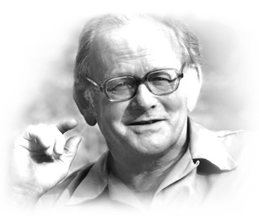
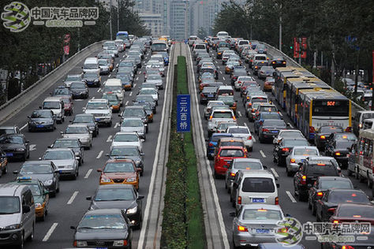
拥塞：公共资源的悲剧
The Tragedy of the Commons
Hardin Science 1968
Different sources compete for “common” or “shared” resources inside network
Sources are unaware of current state of resource
Sources are unaware of each other
Conflicts with collective interests: if all sources do this to drive the system to overload, throughput gain is NEGATIVE, and worsens rapidly with incremental overload => congestion collapse!!
Notes:
Hardin于1968年发表于Science的文章“公用的悲剧”(The Tragedy of the Commons)可以说是迄今为止描述资源两难问题的最有影响力的文章。在文中Hardin认为现代人过度使用资源的后果将是面临类似于使用同一牧场的牧人所面临的悲剧：在公用牧场之中放牧的牧人尽可能地多饲养牲口以使自己的利益最大化，而这种行为导致的长期后果是牲口的总数超出了牧场所能容纳的极限，草资源很快枯竭。所有的牲口也因为没有足够的食物而面临饿死的境地。
引入产权是此问题的主要解决方案。

Slide 20
拥塞：公共资源的悲剧
In October 1986 the ARPANET suffered major congestion collapse
The effects of this collapse were later described by Van Jacobson
Data throughput from LBL to UC Berkeley (sites separated by 400 yards and two IMP hops) dropped from 32 Kbps to 40bps
Notes:
Hardin于1968年发表于Science的文章“公用的悲剧”(The Tragedy of the Commons)可以说是迄今为止描述资源两难问题的最有影响力的文章。在文中Hardin认为现代人过度使用资源的后果将是面临类似于使用同一牧场的牧 人所面临的悲剧：在公用牧场之中放牧的牧人尽可能地多饲养牲口以使自己的利益最大化，而这种行为导致的长期后果是牲口的总数超出了牧场所能容纳的极限，草资源很快枯竭。所有的牲口也因为没有足够的食物而面临饿死的境地。

Slide 21
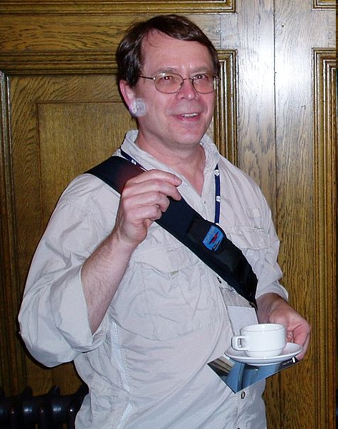

Van Jacobson
Jacobson is best known for his work in redesigning TCP/IP's flow control algorithms (Jacobson's algorithm) is said to have saved the Internet
Furthermore he has co-written a few widely used tools, such as traceroute, pathchar and tcpdump
For his work, Jacobson received the 2001 ACM SIGCOMM Award

Slide 22
Congestion Control
Two sides of the same coin
pre-allocate resources so at to avoid congestion
control congestion if (and when) is occurs

Slide 23
Example
Consider an ISP that would allow up to 1000 simultaneous data flows
Each of which would have a maximum rate of 1 Mbps, but an average rate of only 300 kbps.
Would it make sense to connect their Internet gateway to a 1 Gbps link (which means that all of them could be accommodated at all times), or would, say, 600 Mbps be enough?

Slide 24
Example (Cont’d)
assume that the ISP chooses the 600 Mbps option (since it’s cheaper)
In this case, the gateway would see occasional traffic spikes that go beyond the capacity limit if a certain number of customers use their maximum rate at the same time.

Slide 25
Consequence
Since these excess packets cannot be transferred across the link
there are only two things that this device can do:
buffer the packets (however queue is limited)
or drop them.
When queues grow, the network is said to be congested; this effect will manifest itself in increasing delay and, at worst, packet loss.

Slide 26
Overprovision or control?
Overprovision
the common choice of ISPs is to serve the aforementioned 1000 flows with 1 Gbps or even more in order to avoid congestion within their network.
Congestion control
The goal of congestion control mechanisms is simply to use the network as efficiently as possible,
attain the highest possible throughput while maintaining a low loss ratio and small delay.

Slide 27
Congestion Control
From overprovision to control
‘how to eliminate congestion’
‘how to efficiently use all the available capacity’.

Slide 28
Congestion Collapse
The Internet first experienced a problem called congestion collapse in the 1980s.
Referred to as when a condition occurs where increasing sender rates reduces the total throughput of a network.
it is described as a stable condition of degraded performance that stems from unnecessary packet retransmissions.

Slide 29
Example 1
4
100kbps
0
100kbps
300kbps
3
1Mbps
2
100kbps
1
5
Link capacity
0-2,1-2,3-4:100kbps
2-3:300kbps
3-5:1Mbps
Two UDP connections: 0→4, 1→5
Each source started with a rate of 64 kbps and increased it by 3 kbps every second. (no decease phase)

Slide 30
In Example 1, there will be no collapse
throughput increases until both senders reach the capacity limit of their access links. There is no collapse
4
100kbps
100kbps
0
300kbps
2
3
1Mbps
100kbps
1
5

Slide 31
Example 2
but what happens when the bandwidth of the 0–2 (100k→1M) link is increased?
1Mbps
4
0
100kbps
300kbps
3
1Mbps
2
100kbps
1
5

Slide 32
Congestion Collapse
For 1→5: as the rate approaches the capacity limit, the throughput curve becomes smoother (knee), beyond a certain point, it suddenly drops (the so-called cliff) and then decreases further.
While 0→4 remains almost same, (limited to 100 kbps by the connection between nodes 3 and 4.)
4
1Mbps
100kbps
0
300kbps
2
3
1Mbps
100kbps
1
5

Slide 33
Strange Phenomenon
Congestion at node 2 – a queue will grow
Roughly, for every packet from customer 1, there are 10 packets from customer 0.
Basically, this means that the packets from customer 0 unnecessarily occupy bandwidth of the bottleneck link that could be used by the data flow coming from customer 1
the rate will be narrowed down to 100 kbps at the 3–4 link anyway.
The more the customer 0 sends, the greater this problem.

Slide 34
Queue at Router 2
since both sources keep increasing their rates no matter what the capacities beyond their access links are, there will be congestion at node 2 – a queue will grow,
and this queue will have more packets that stem from customer 0.

Slide 35
拥塞过程的全貌
knee – point after which
throughput increases very slowly
delay increases fast
cliff – point after which
throughput starts to decrease very fast to zero (congestion collapse)
delay approaches infinity
Note (in an M/M/1 queue)
delay = μ⁻¹/(1 – ρ)
ρ= λ/ μ
knee
cliff
packet
loss
Throughput
congestion
collapse
Load
Delay
Load
Notes:
ρ= λ/ μ
λ是到达速率
μ是服务速率

Slide 36
The Need for Congestion Control
If customer 0 knew that it would never attain more throughput than 100 kbps and would therefore refrain from increasing the rate beyond this point, customer 1 could stay at its limit of 100 kbps.
A technical solution is required for appropriately reducing the rate of customer 0; this is what congestion control is all about.

Slide 37
Why Congestion Control
1. Avoid congestion collapse (for the whole network)
2. Fairness (for other opponent flows)
3. Better achieve its own goals in delay/loss/throughput (for applications)

Slide 38
Congestion Avoidance
Schemes that allow the network to operate at the knee are called congestion avoidance schemes, whereas congestion control just tries to keep the network to the left of the cliff.
In practice, it is hard to differentiate mechanisms like this as they all share the common goal of maximizing network throughput while keeping queues short.
Sometime interchangeable

Slide 39
拥塞控制和拥塞避免
Congestion control goal
stay left of cliff
Congestion avoidance goal
stay left of knee
Right of cliff:
Congestion collapse
knee
cliff
Throughput
congestion
collapse
Load

Slide 40
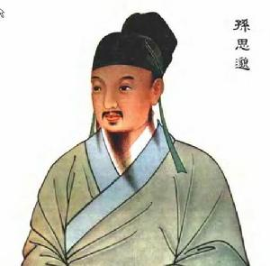
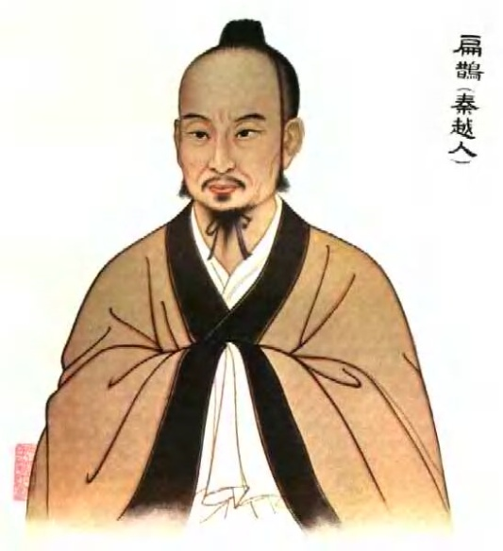
拥塞控制和拥塞避免
唐代孙思邈《千金要方·论诊候第四》
古人善为医者，上医医未病之病，中医医欲病之病，下医医已病之病，若不加心用意，於事混淆，即病者难以救矣
扁鹊曰：长兄于病视神，未有形而除之，故名不出于家。中兄治病，其在毫毛，故名不出于闾。若扁鹊者，血脉、投毒药、副肌肤间，而名出闻于诸侯 《鹖冠子》

Slide 41
拥塞崩溃
Definition: Increase in network load results in decrease of useful work done
Many possible causes
Spurious retransmissions of packets still in flight
Undelivered packets
Packets consume resources and are dropped elsewhere in network
Fragments
Mismatch of transmission and retransmission units
Control traffic
Large percentage of traffic is for control
Stale or unwanted packets
Packets that are delayed on long queues

Slide 42
Congestion control and flow control
The goal of flow control is to protect the receiver from overload, whereas the goal of congestion control is to protect the network.
The two functions lend themselves to combined implementations because the underlying mechanism is similar:
feedback is used to tune the rate of a flow.
Sending rate= MIN (flow controled, congestion controled)
Sometimes also interchangeable, or one is regarded as a special case of the other

Slide 43
Example
1→5: max rate=100kbps by CC
However, if 5 can only process data (e.g. read buffer) at 50kbps, then flow control enforced

Slide 44
Congestion Control History
Congestion control is a very old research topic. (about 30 years)
In Oct. 1986, 5,089 hosts on Internet
Internet suffered from it’s first collapse
Reason
Early TCP (from 1974) flow control only prevents overwhelming receivers
Paths clogged with unnecessarily-retransmitted packets

Slide 45
Milestone in Congestion Control
Milestone: Van Jacobson,” Congestion Avoidance and Control”, ACM SIGCOMM 1988
TCP Tahoe (include congestion control in TCP)

Slide 46
Congestion Control Today
Now, it’s still a hot topic
In specific networks (wireless, data center)
In specific scenarios (LFP…)
with new methods (e.g. machine learning)

Slide 47
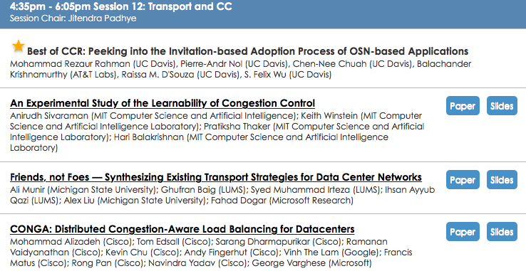
ACM SIGCOMM 2014

Slide 48
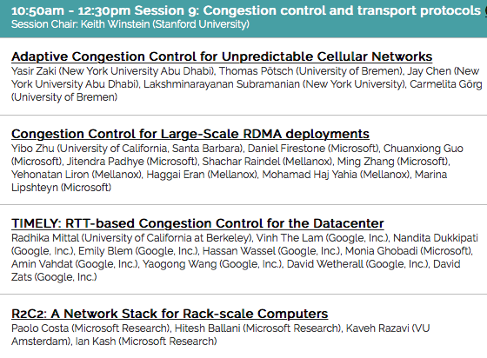
ACM SIGCOMM 2015

Slide 49
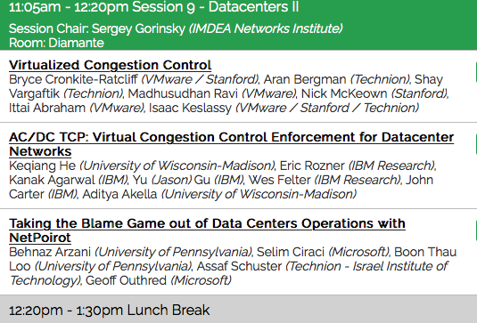
ACM SIGCOMM 2016

Slide 50
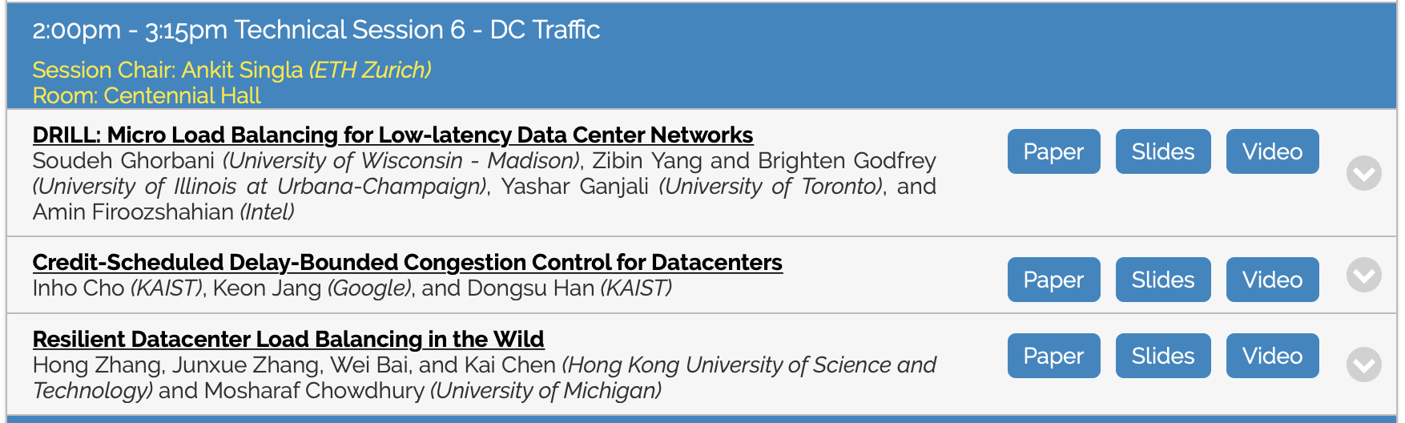
ACM SIGCOMM 2017

Slide 51
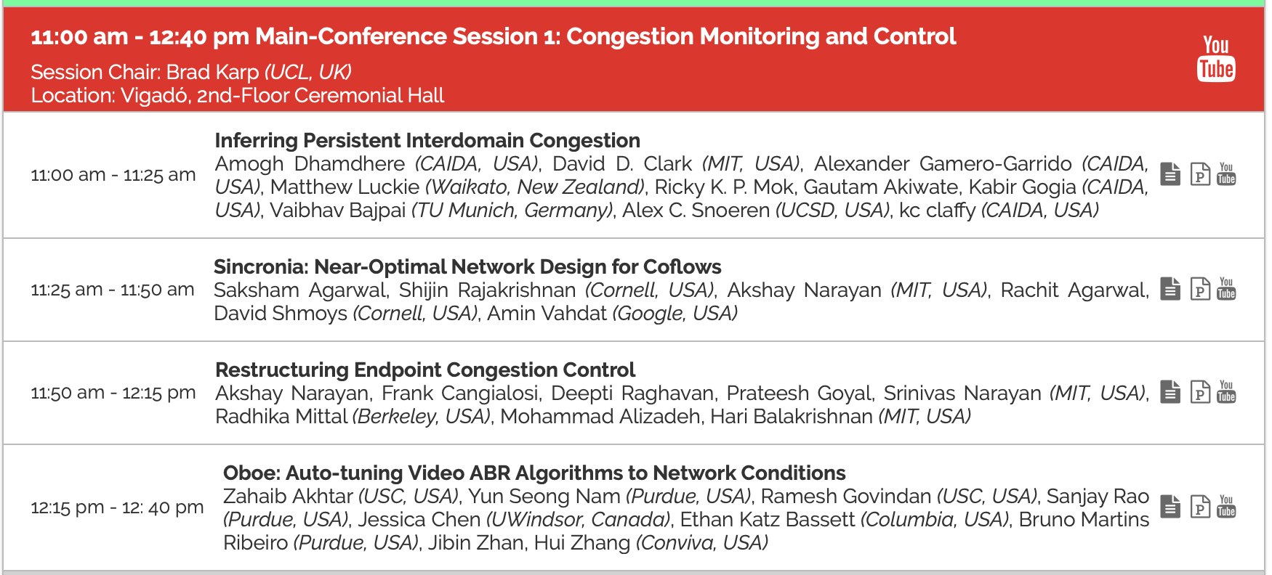
ACM SIGCOMM 2018

Slide 52
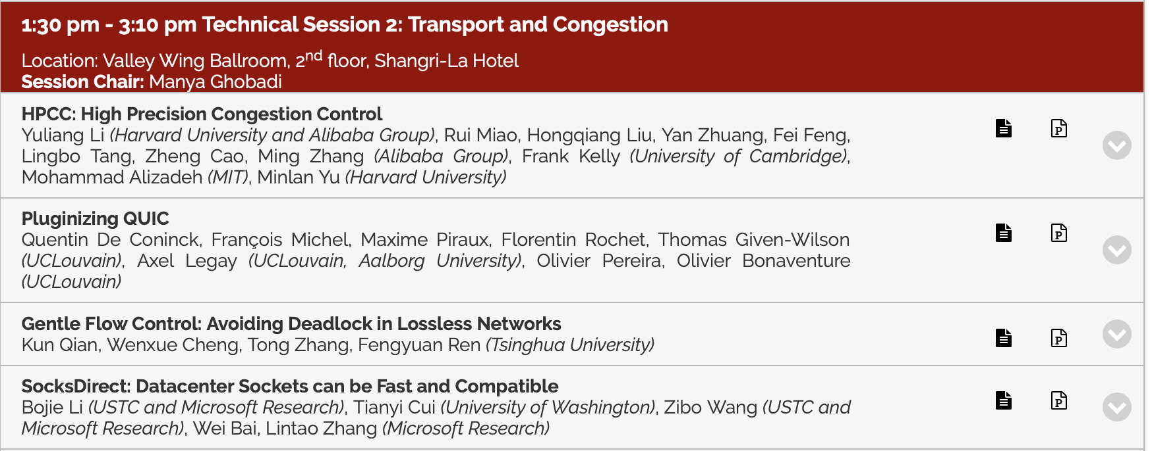
ACM SIGCOMM 2019

Slide 53
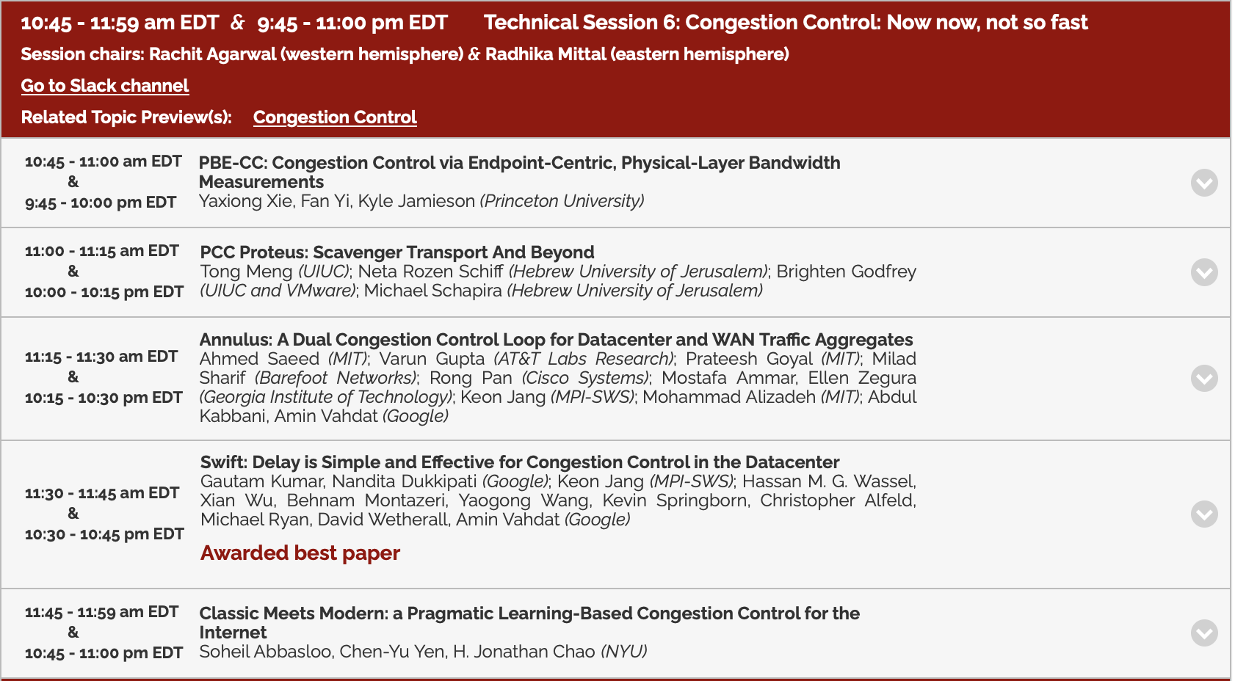
ACM SIGCOMM 2020

Slide 54
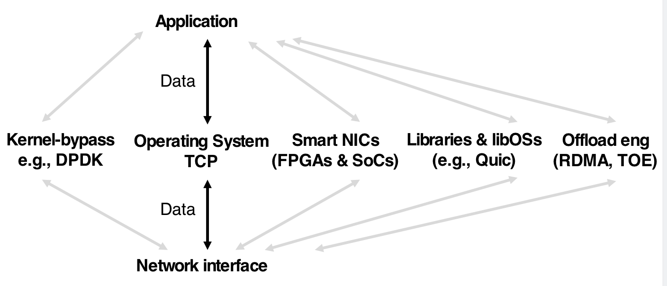
Trends in Congestion Control
Trend #1: New datapaths
Apps with strict perf reqs
Apps with unique needs

Slide 55
Trend #2: New algorithms
Nimbus
Indigo
Vivace
XCP
RCP
DCTCP
RC3
ABC
H-TCP
FAST
LEDBAT
NV
BBR
Vegas
Veno
Hybla
Illinois
Remy
PCC
Copa
Reno
EBCC
Westwood
Compound
Sprout
TIMELY
Tahoe
NewReno
Binomial
BIC
Cubic
PRR
DCQCN
1987
1998
2001
2010
2018
Improving deployed algorithms
Changing application requirements
Different deployment scenarios
Using new algorithmic tools

Slide 56
There are many new challenges for Congestion control
but we need understand the basic Design Considerations first

Slide 57
CC: Design Considerations
How could one design a mechanism that automatically and ideally tunes the rate of the flow from customer 0 in our example?
A typical solution:
measure the network state
control the rate
But, how?

Slide 58
3 elements
3 elements involved in connection:
Traffic originates from a sender
each packet usually traverses a certain number of intermediate nodes
traffic reaches a receiver.
2
3
1
5

Slide 59
CC: Design Considerations
Controllers
Traffic can be controlled at the sender and at the intermediate nodes;
Measuring points
performance measurements can be taken by intermediate nodes and by the receiver.
at least one controller and one measuring point must participate in any congestion control scheme that involves feedback.

Slide 60
Closed-loop versus open-loop
In control theoretic terms, systems that use feedback are called closed-loop control as opposed to open-loop control systems, which have no feedback.
Neglecting feedback is clearly not a good choice when it comes to dissolving network congestion
dynamics of the system – the presence or absence of other flows

Slide 61
Open-loop case
applying open-loop control would mean using a priori knowledge about the network
for example, the bottleneck bandwidth
If the access link is the bottleneck, the sender thus can limit its sending rate without feedback

Slide 62
Feedback
a general-purpose congestion control scheme will normally have the sender tune its rate on the basis of feedback from the receiver
Recall that
Measuring points: intermediate nodes /receiver.
However adding measuring functions within network will complicate things significantly
implicit feedback
measurements that are taken at the receiver and can be used to deduce what happens within the network.

Slide 63
Implicit Feedback
What can happen to a packet as it travels from source to destination? from an end-node perspective,
1. It can be delayed.
2. It can be dropped.
3. It can be changed.

Slide 64
Delay
Delay can have several reasons:
Distance :sending a signal to a satellite and back again takes longer than sending it across an undersea cable
queuing processing in the involved nodes
or retransmissions at the link layer.

Slide 65
Packet Drop
a queue length is exceeded,
a user is not admitted,
equipment malfunctions,
link noise causes a checksum of relevance to intermediate systems to fail. (e.g. packet will be discarded upon checksum mismatch at router)

Slide 66
Changing a packet
altering its header or its content (payload).
How do we choose a feedback?
…

Slide 67
Queue
Good news: ‘queue’ was mentioned twice
Delay and drop
at least the factors ‘delay’ and ‘packet dropped’ can indicate congestion.
Bad news:
Each can happen to a packet can have quite a variety of reasons
Relying on these factors therefore means that implicit assumptions are made about the network
e.g. assuming that increased delay always indicates queue growth could mean that it is assumed that a series of packets will be routed along the same path).

Slide 68
Packet loss
Packet loss can be regarded as an the implicit feedback
What the problem?
Provided that packets are mainly dropped when queues overflow;
For wireless
wireless (and therefore noisy) Internet connections poses a problem because it leads to a misinterpretation of packet loss;

Slide 69
Binary feedback
let us once again focus on the simplest case:
a notification that tells the source ‘there was congestion’.
What can a sender do in response to a notification that simply informs it that the network is congested?
Obviously, in order to avoid congestion collapse, it should reduce its rate.
If there was no congestion
Need a rule for the sender that says ‘increase the rate if the receiver says that there was no congestion

Slide 70
拥塞控制的解决思路
End-to-end congestion control
no explicit feedback from network
congestion inferred from end-system observed loss, delay
approach taken by TCP
Network can help
routers provide feedback to end systems
single bit indicating congestion (SNA, DECbit, TCP/IP ECN, ATM)
explicit rate sender should send at

Slide 71
端到端模型
End-systems is ultimately the source of “demand”
End-system must robustly estimate the timing and degree of congestion and reduce its demand appropriately
Must trust other end hosts to do right thing
End-systems can be helped to detect congestion by routers
Key: trust and complexity resides at end-systems
Issue: What about misbehaving flows?

Slide 72
基本控制模型
Let’s assume window-based operation
Reduce window when congestion is perceived
How is congestion signaled?
Either mark or drop packets
When is a router congested?
Drop tail queues – when queue is full
Average queue length – at some threshold
Increase window otherwise
Probe for available bandwidth – how?

Slide 73
如何检测拥塞
Explicit network signal
Send packet back to source (e.g. ICMP Source Quench)
Control traffic congestion collapse
Set bit in header (e.g. DEC DNA/OSI Layer 4, ECN)
Can be subverted by selfish receiver
Unless on every router, still need end-to-end signal
Could be robust, if deployed

Slide 74
如何检测拥塞
Implicit network signal
Loss (e.g. TCP Tahoe, Reno, New Reno, SACK)
+relatively robust, -no avoidance
Delay (e.g. TCP Vegas, BBR)
+avoidance, -difficult to make robust
Easily deployable
Robust enough? Wireless?

